Slide 1
22.
COMP 3329 Group Project
Chau Wing Yu
Wan Ho Cheung
Wong Lok Hei
Susanto Christopher Alvin

Slide 2
Inspiration.
Audition Online (勁舞團)
Musical: 8-beat-1-space
Mechanics: Challenging!
Interactive: Multiplayer
Enjoy: Your favourite music ~
Boo: No storyline to follow

Slide 3
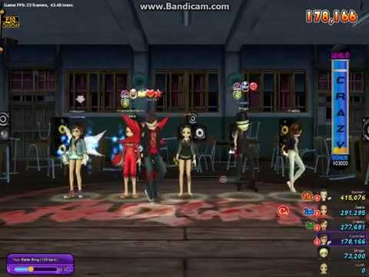
Audition Online: Gameplay

Slide 4
Lost Slime: Find me a new Home!
Genre: Educational / Musical
Scope: PvP mode (default), high-score mode (single), survival mode (endless)
Storyline:
Slimey is lost! It’s been strolling around a plain field with nothing nearby...
Help Slimey! Build a pillar to elevate Slimey to give it HIGH vision...
The HIGHER Slimey goes, the more likely it’s going to find a shelter!
Build the pillar optimally! Follow your music beats for best performance!
Platform: PC with Google Chrome

Slide 5
GAME RULES
Slimey begins the game on the ground. Full of grass and dirt. Yuck!
For each 8-beats, type all on-screen words and press SPACE BAR to give Slimey a pillar to jump on! The taller the pillar, the more vision it has!
Typings are only registered within each 8-beats, they have TIME LIMITS!
Time your SPACE BAR to the beat! Failed presses will forfeit current pillar!
Slimey will be able to find his home if you reach certain height before music ends. Win-win in the end!

Slide 6
Technology
Mechanics
Player chooses a song to cheer Slimey up: the game starts!
The more words properly typed a TALLER pillar will be given!
Higher score is given to:
More properly-typed words
PERFECT space presses
LONGER streak in combo system
Faster songs have shorter phrases. Vice-versa.
Platform: Web app (browser)
Node.js, Express, SOCKET.IO 2.0
Slimey: 3D Model with Blender (?)
Music is used
Dynamically generated background & VFX per song

Slide 7

Story
Aesthetics
Bring Slimey to a high ground for finding a new shelter!
When you win the game, Slimey also finds its new home!
Connects players with Slimey, brings out your SYMPATHY
2.5D: Slimey is a cute 3D model jumping around for his home!
Parallax view: background moves while Slimey is climbing. DEPTH!
Lighthearted cheerfulness: Slimies have different colors!

Slide 8

GLHF
Slimey loves u :)

